Slide 1
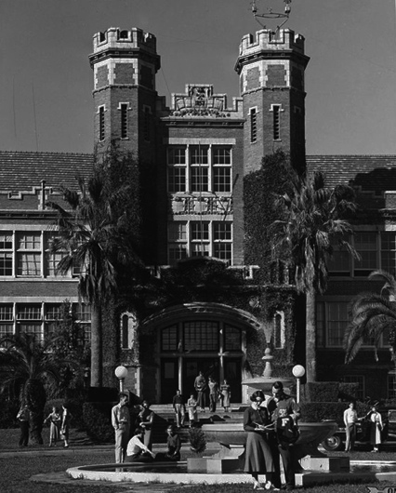
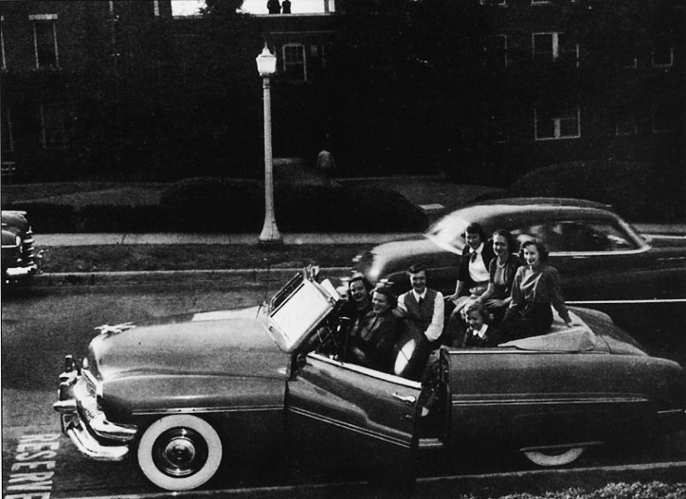
HERITAGE PROTOCOL &
UNIVERSITY ARCHIVES
Notes:
Good evening everyone, For 164 years, Florida State University in its many incarnations has been an institution of higher learning. Since 2001, a campus wide initiative called the Heritage Protocol Program has been the driving force behind documenting that history through identifying, acquiring, cataloguing, preserving, and providing access to all materials that tell the story of FSU

Slide 2
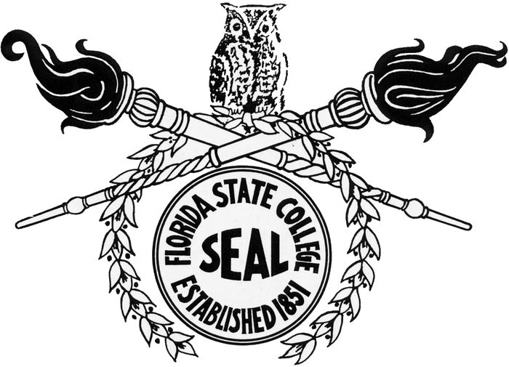
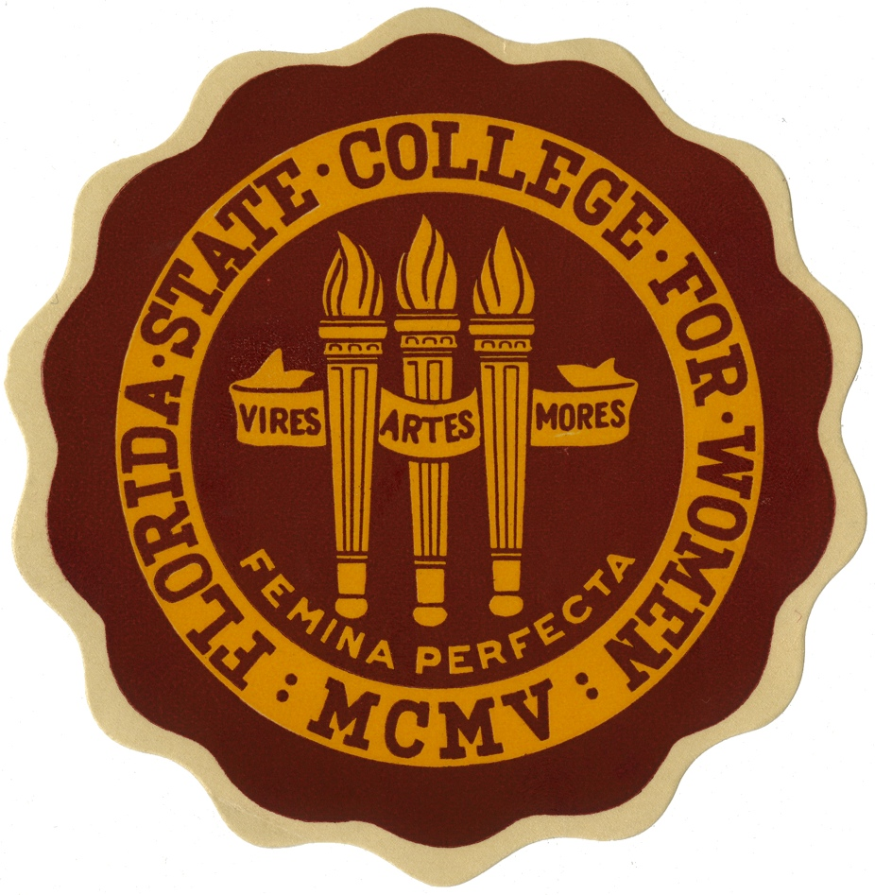
Florida State University
1851 - by an act of the General Assembly of Florida to creating two seminaries of higher learning; one east of the Suwannee, and one west
1885 Florida Institute – secondary school and college
1857 Tallahassee selected West Florida Seminary
1858 Absorbs Leon Female Academy
1 Florida Military and Collegiate Institute
1865 West Florida Seminary
Florida University (part of the first official university in the state)
1885 Recognized as part of University of Florida (act repealed 1903)
1901 Florida State College
1905 Florida Female College
1909 Florida State College for Women
1947 Florida State University

Slide 3
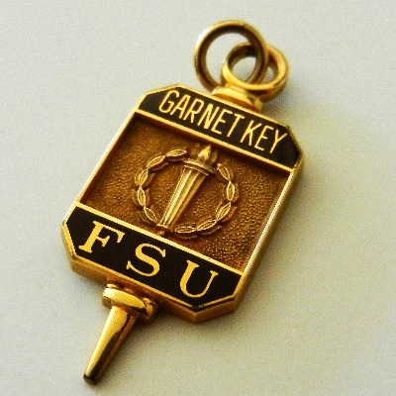
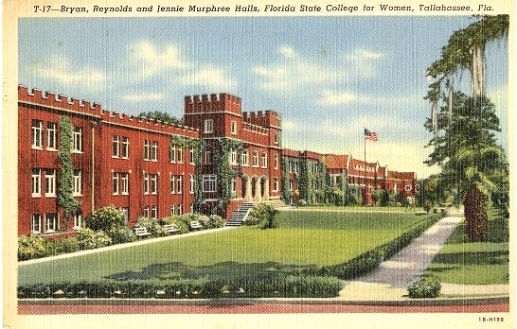
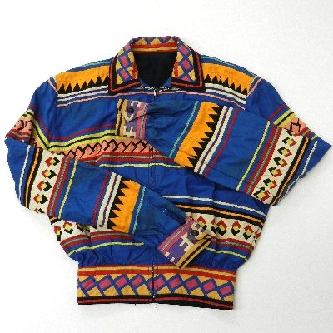
Program Beginnings
During the early 2000’s Heritage Protocol’s development was propelled forward by FSU’s 150th Anniversary
Sporadic official records
Alumni memorabilia rejected by due to space
Scattered materials
Interested alumni, faculty, and community members joined to strategize on how to document and preserve institutional history
University Relations/Libraries/Alumni Association establish HP 2005
University Archives/Heritage Protocol separate
Alumni Association collection is the basis for Heritage Protocol

Slide 4
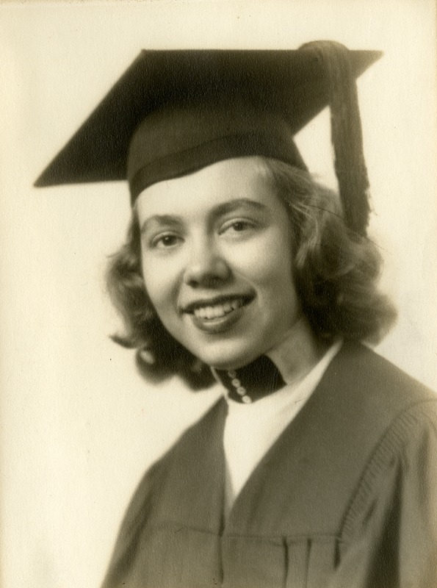
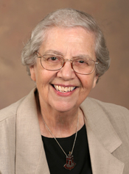
Mission Statement
The mission of Heritage Protocol & University Archives is to locate, identify, record, assist in the preservation of, and promote knowledge about the history of Florida State University and its predecessor institutions.
“When we initiated Heritage Protocol at FSU, we unwittingly emphasized this aspect Heritage Protocol at Florida State University of the university history because I was not only the archivist but also an alumnus of FSU. As I have a natural fondness for my alma mater, I found documenting student life an appealing and attractive direction in which to take the program.” E. Woodward.
Mary Lou Norwood
FSCW Class of ‘47
Notes:
College Hall (remodeled 1891)

Slide 5
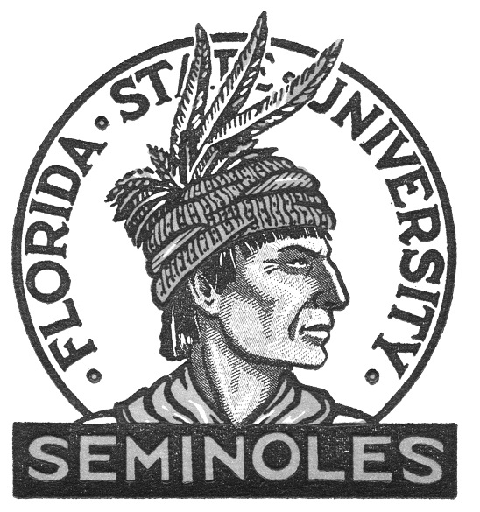
Program Structure
The Heritage Protocol Executive Committee
Ambassadors
“How to set up a Departmental Archive”
Reporting to:
2007 – 2009
Associate Dean for Access Services
2009-2012
Dean of Libraries
2012-2015
Associate Dean of Special Collections & Archives
Heritage Protocol: Alumni Collections
University Archives: Records

Slide 6
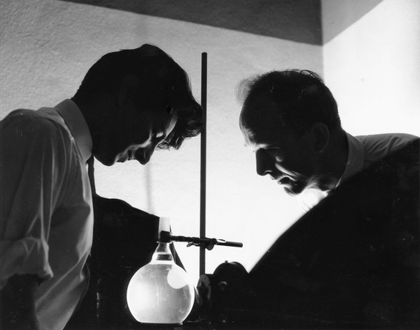
Program Evolution
During 2014 Heritage Protocol underwent significant changes through a variety of collection management and outreach projects to better define the program, collections, and increase access
Comprehensive collection policy
Records Transfer
Revision of “Archival Materials Policy”
Comprehensive collections review
Staffing
Administrative cleanup
Increased reference
Coordinated social media effort
Heritage Museum
Tours, events, meetings with departments, donors

Slide 7
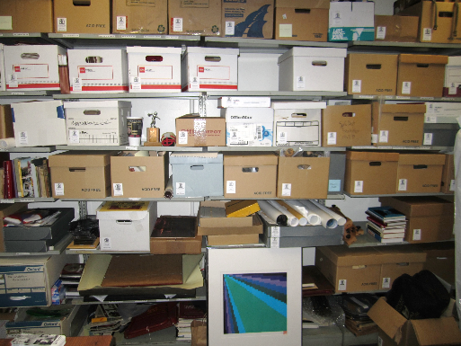
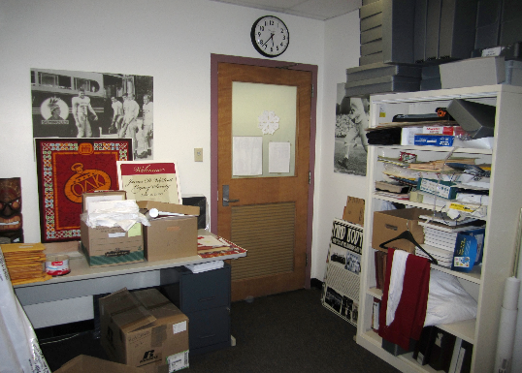
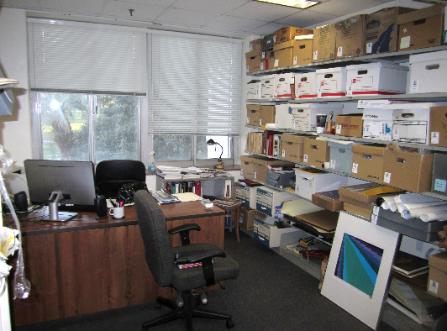
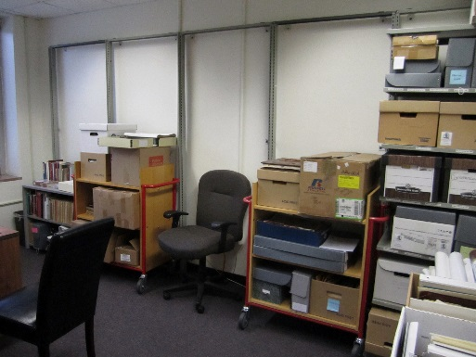
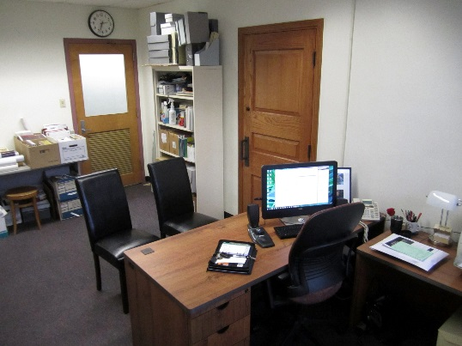
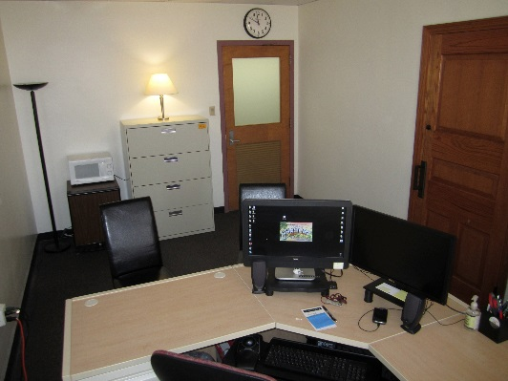
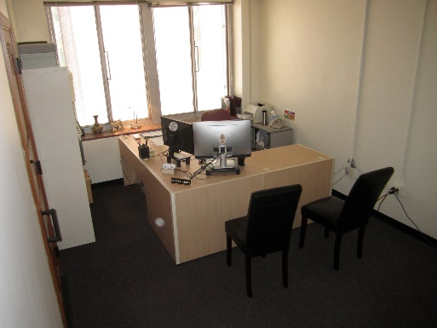
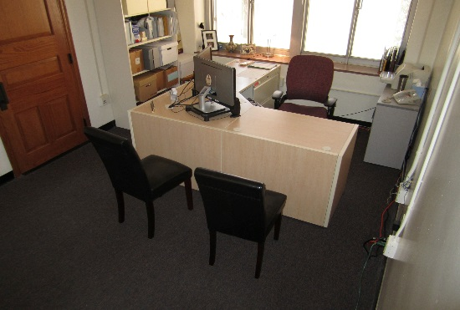
Collections - Housekeeping
Notes:
Upper right photo first:
Acquisition – Policies that define what we collect and how. Working with donors, staff, faculty, and alumni to physically obtain the materials. Once items arrive, they must be quarantined and checked for hazards, and then inventoried and assessed for preservation concerns
Appraisal & Selection – Inventory, deciding what is to be kept, or returned, or disposed of
Preservation – Before during and after - Collections need everything from basic to advanced preservation and conservation to ensure their survival and accessibility for current and future generations
Processing – physically arranging and describing the items for organization and access.
Access – through physically looking at manuscripts – to digitization projects and requests for materials
These specialized activities require materials and staff, and therefore often times a monetary donation coincides with that of the materials.
These activities are the essential duties of the archivst, and are necessary for the collections to be used by researchers of all kinds

Slide 8
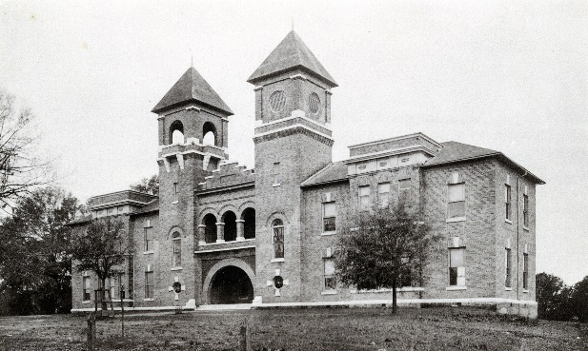
Collecting Policy
University Records Policy
Maintains the original character of Heritage Protocol
while coordinating with institutional records management
Better defines university records and distinguishes them
from other manuscripts and faculty papers
Updating FSU’s official policy to more clearly articulate what historical
records are and what each department’s responsibility is
Records Transfer is a tool to document collections
Notes:
College Hall (remodeled 1891)

Slide 9
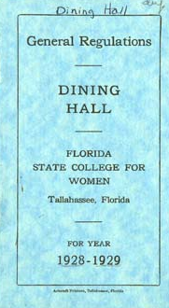
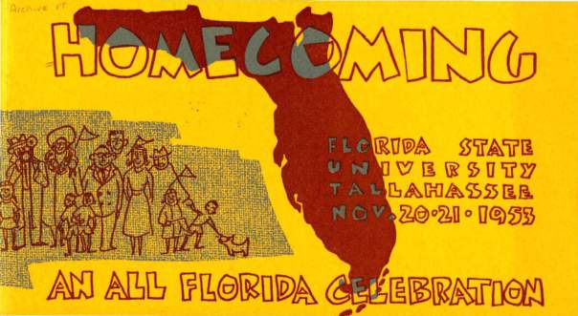
Collections
Comprehensive collection review to locate and
document all HPUA collections resulting in the first
extent value
Review of 1100+ linear feet of existing manuscript
collections to determine their potential inclusion in
HPUA as well as to identify preservation issues
Maintenance & retroactive cleanup of
accession log for years 2008-2014.
2007 and previous is ongoing.

Slide 10
Collections
Heritage Protocol & University Archives is currently 4394.75 linear feet

Slide 11
Collections
Collections accessioned in 2014 = 217.75 linear feet

Slide 12
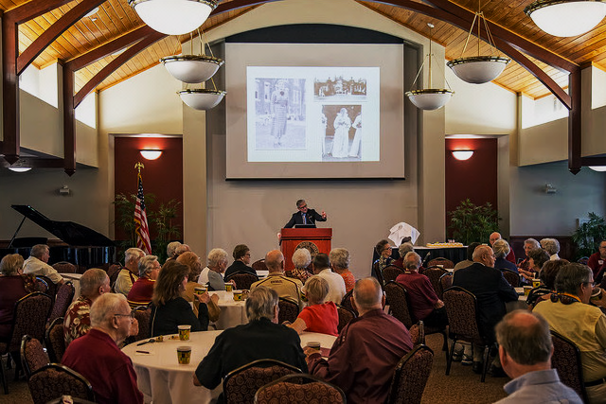
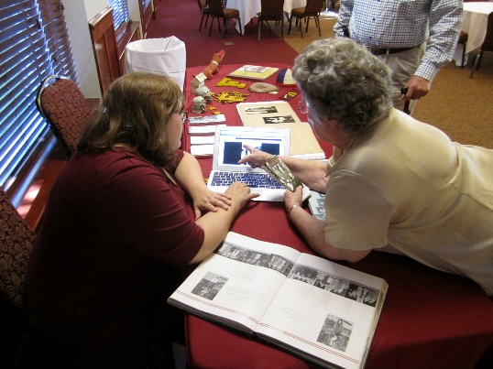
Outreach & Access

Slide 13
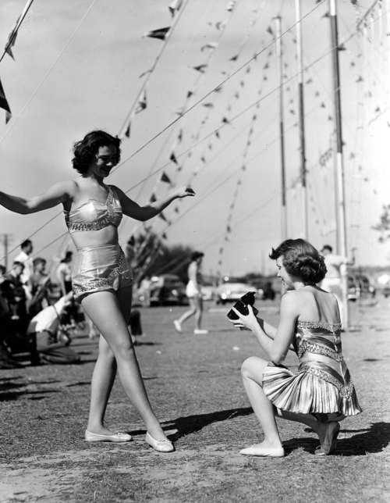
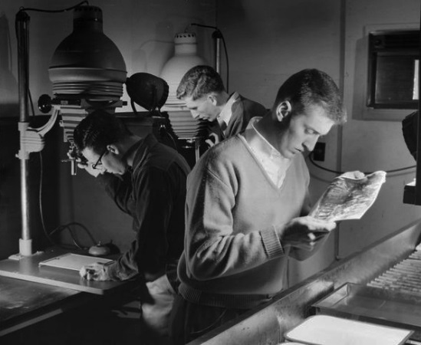
Outreach & Access

Slide 14
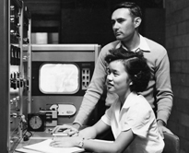
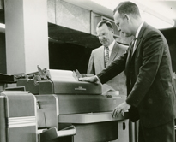
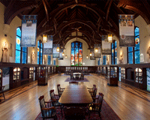
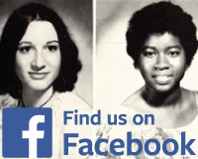
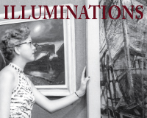
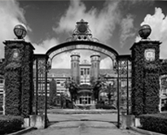
Portal
Finding Aids
Digital Collections
University Records
Museum
Legacy Walk

Slide 15
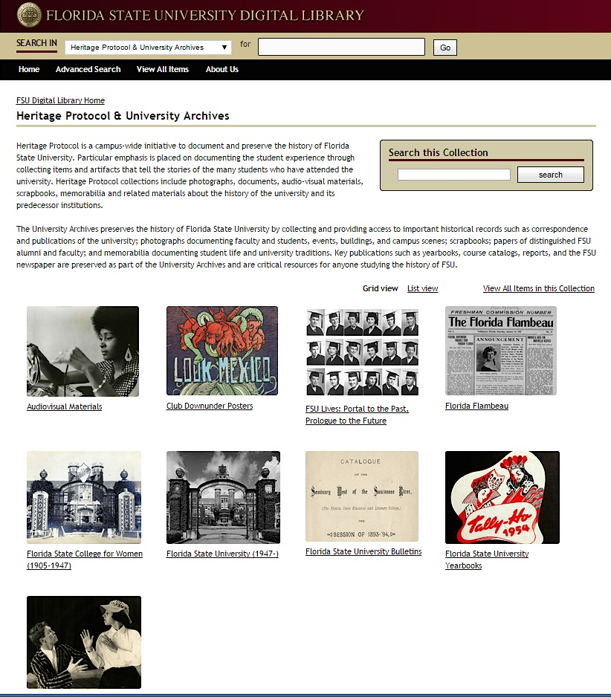
Outreach & Access

Slide 16
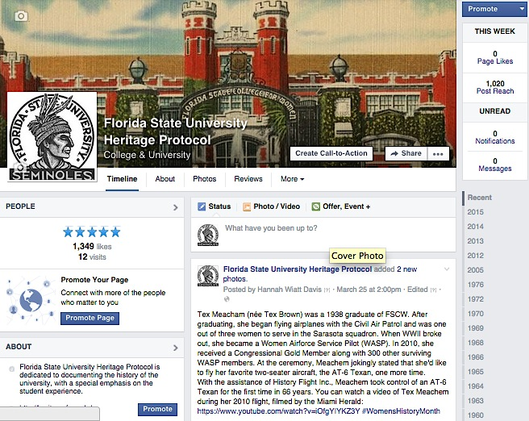
Facebook

Slide 17
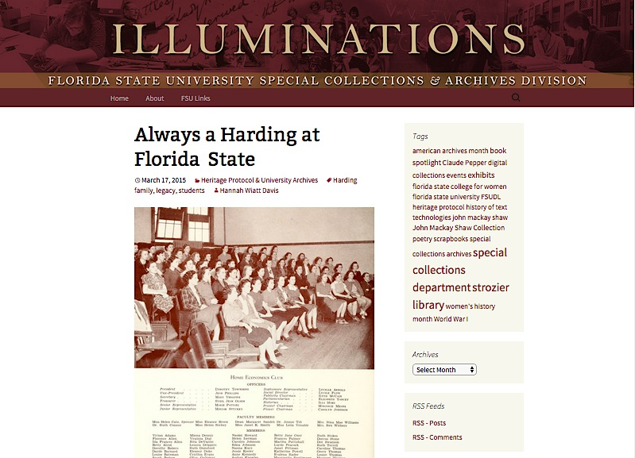
Blog

Slide 18
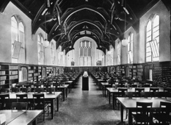
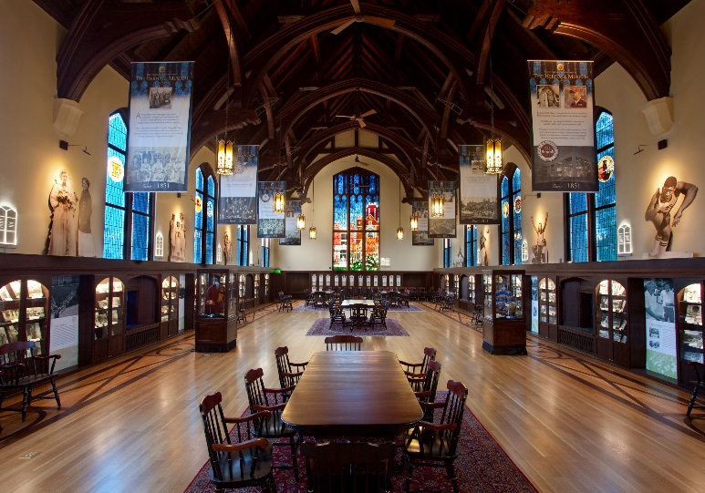
Heritage Museum
Heritage Museum Visitors Fall 2014= 982

Slide 19
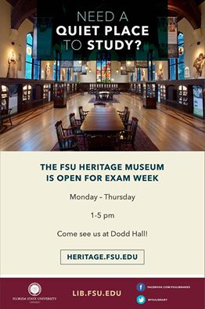
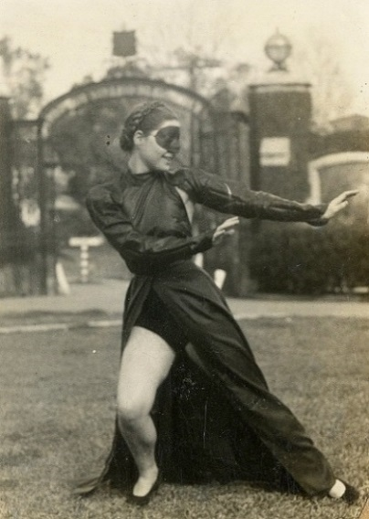
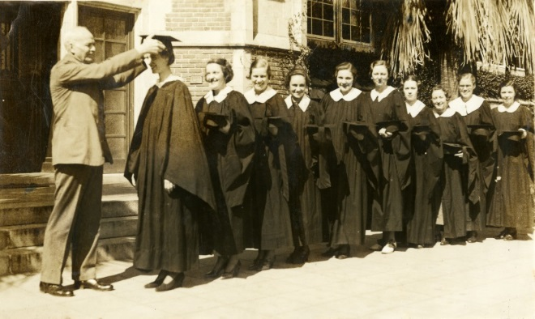
Looking Forward
Increasing outreach
activities
engagement
Increasing awareness
departments/ records
student groups/new alumni
Service
New exhibits
Processing
Digital collections
digitzation
born digital
Partnerships

Slide 20
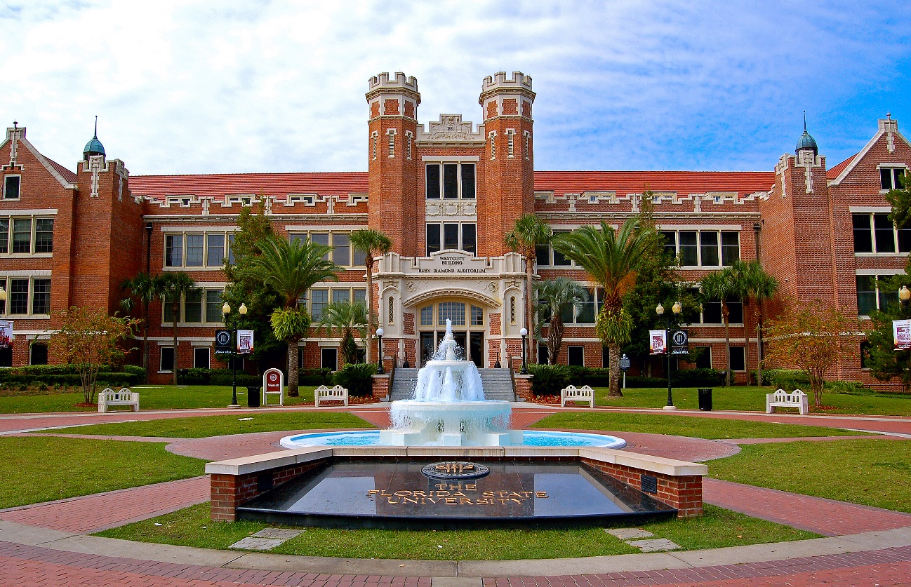
Sandra Varry, MFA, MLIS, CA
Heritage Protocol & University Archivist
Special Collections & Archives
Florida State University Libraries
heritage.fsu.edu

