Slide 1
Checking in on Revealing Hidden Collections at FSU
Katie McCormick, Krystal Thomas and Sandra Varry
May 13, 2015

Slide 2
The Issue(s)
Collection information in multiple places, not consistent
No collection information available
Collections information only available through a physical visit to the reading room
We did not have a good understanding of the issues
We did not have intellectual control of our collections
We could not provide access to many collections

Slide 3
The Ultimate Goal(s)
For Manuscript and Archives Collections to
Have complete online access
Be fully searchable (at least at the collection level)
Have coordinated representation in multiple access points
To reach our collections goal(s) as quickly as possible
To think creatively about solutions to our issues

Slide 4
Phase 1: 2012-2013
Full review of online presence
Phase 2: 2013-2014
Analyze data
Phase 3: 2014-
Regroup & analyze new data & issues
Identify issues
Create next steps
Create comprehensive spreadsheet of collections
Clean Up simple issues
Physical review of problematic collections
Create Priorities, define workflows
Archives Florida Data Migration
Define & perform clean up work in key areas
Reclassification
Reprocessing
Preservation
Cataloging & Description
Further Physical Review

Slide 5
2012> 7 FTE (3 faculty, 4 staff), 2 PTE
2015> 5 FTE (3 faculty, 2 staff), 2 PTE
Special Collections & Archives Division
Research Center
Heritage Protocol & University Archives
Claude & Mildred Pepper Library
Digital Library Center
Cataloging & Description
2012 (Reorg)>10 FTE (4 faculty, 6 staff)
2015>10 FTE (4 faculty, 6 staff)
2012>1 FTE (faculty)
2015>1 FTE (faculty), 1 PTE
2012 (Reorg)>2 FTE (staff)
2015> 5 FTE (2 faculty, 3 staff), 2-3PTE
2012>1 FTE (staff), 1 PTE
2015>2 FTE (1 faculty, 1 staff), 1 PTE

Slide 6
Phases 3 & 4
Phases 2 & 3
Phases 1 & 2
Phase 1
# of month position occupied each year

Slide 7
What have we done and who was involved?

Slide 8
The Numbers
Our initial review totaled 1176 collections; our list of active collections is now 766.
Deaccessioned collections
Cataloged as Book
Vertical File Objects
Merged collections
Duplicate records for collections

Slide 9
Numbers Side by Side
After Our Initial Review
Currently

Slide 10
Keeping Track
Notes:
Managing the spreadsheet – tracking the stats but also any notes, changes, problems etc. This is the history of the project but also the history of many of the collections themselves
Figuring out what piece to work on next – the spreadsheet allows us to parse work into categories. For example, we’re working on the library catalog record clean up right now – I started with the set that only needed a link added or fixed into Archon, now they are working on the the collections which have no library catalog record at all.
We also use the spreadsheet to find things as it might be the only record of the collection that exists
This use often leads to more action on a collection – maybe it needs to be added to the Problem Collection list or to one of our other categories (deaccessioned, cataloged as a book, missing)

Slide 11
Migrating Information
From Archives Florida
To FSU Archon
Outdated and Incorrect Information
Poorly formed EAD XML
Actively Maintained
Ability to export clean EAD XML once we’re ready to move to the next system
Some Accession Record ability

Slide 12
The Interesting Discoveries Along the Way…
Collections we stumbled upon for which we had no record…still
Boxes of Books with bar codes and no records
Newspapers with their own accession numbers
Finding aids of cataloged books and manuscripts
Boxes with inventories that no one knew we had
Notes:
This is from a combination of working on different tasks within the project and also just in the course of our daily work. The Newspaper example would be good here to expand on most

Slide 13
It was time to take stock and re-evaluate what we knew and what we needed to know…
Notes:
Because of our discoveries as we’ve worked on various task projects out of the original inventory work and daily finds, we decided to re-evaluate our information and figure out how best to proceed so that nothing gets missed in the end

Slide 14
A Need to Revisit the Paper Finding Aids
Notes:
Because of working on task projects from the spreadsheet and the migration out of Archives Florida and all the discoveries made, it was decided a full review of our paper finding aids was needed (we had, among other things, found there were more collections with only a paper finding aid than originally thought). A student is working through these and entering any data into Archon – often consults the boxes themselves if needed). After he finishes his pass, I go through, update the spreadsheet, pull the finding aids that are marked as problems, missing, deaccessioned or OCR candidates and those go into their respective workflows.

Slide 15
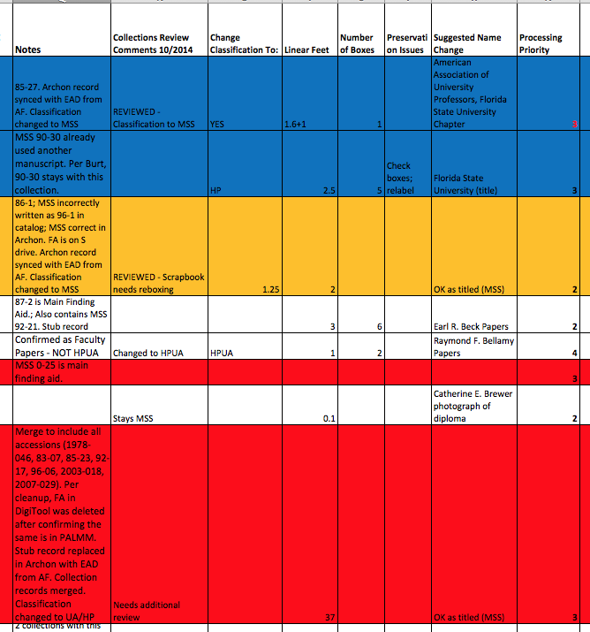
Physical Review - Rationale
To determine what collections need to be classified how
To determine what collections need to be merged
To note storage and preservation issues
Preserve institutional memory

Slide 16
Physical Review – Scope of Work
Manuscript and university archivist reviewed 128 collections over 4 months
128 collections/1146.30 linear feet
Divided into categories to help delineate future work
Given processing priorities to focus efforts

Slide 17
Physical Review – Categories & Extents
Reclassification/Naming 409.70
Merging 199.35
Preservation 53.75
Further Review .50
Reprocessing 464.40
Remaining 18.6
= 1146.3

Slide 18
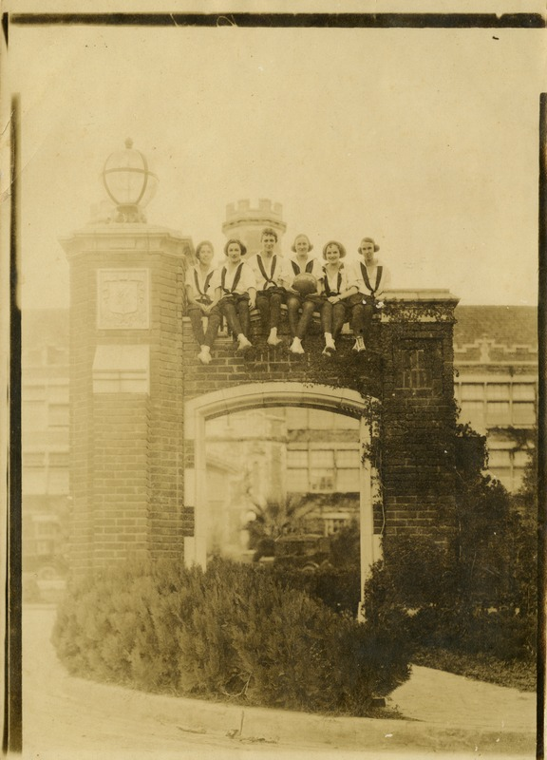
Physical Review – Notable Findings
“FSCW Miscellaneous
Memorabilia”
Items from other
collections including
one of our most valuable
images of The Even
Basketball Team, 1922.

Slide 19
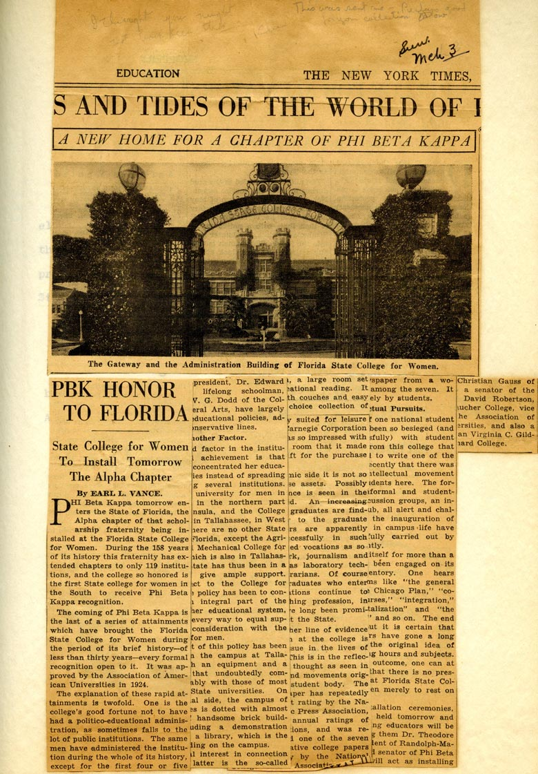
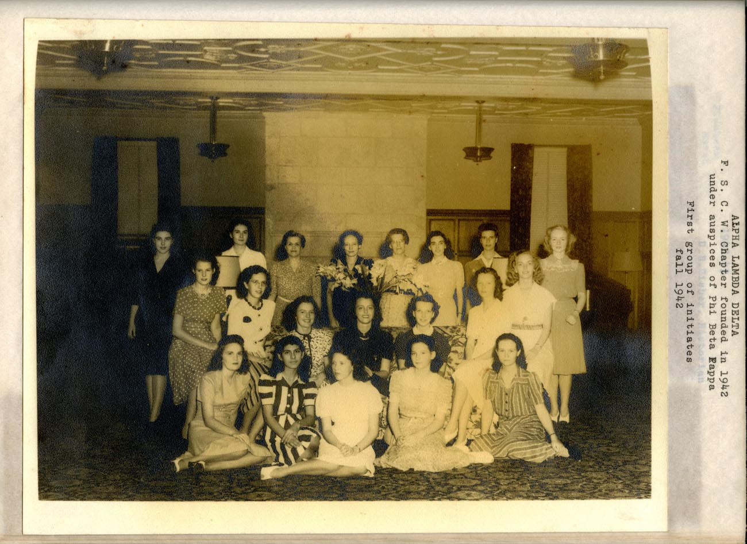
Physical Review – Notable Findings
Phi Beta Scrapbooks – Lost & Found

Slide 20
Where are we now?

Slide 21
Working, Active Inventory Project Spreadsheet
One single location where all aspects of the project can be parsed and tracked by all members of the division
Easily defined categories of materials = easily defined projects that can be tackled
Notes:
This is a one-stop shop so to speak – as I’ve said, it can parse information to create the task projects I’ve discussed but it also allows us to keep track of collections in a cohesive manner that didn’t exist before at FSU. Eventually, all its information will end up in the Admin info in Archon and therefore in the EAD for the collection.
It also gives us a place to share information, discoveries, problems and questions about collections as we work

Slide 22
Single Location for Online Finding Aids
Archon is now the only home for our online finding aids
It is actively maintained and improved on weekly by the division as we continue work on the project
Clean EAD!
Notes:
We have never had a single place you could go and be guaranteed to find all online finding aids for our collections – we do now. Not only that, we can export clean EAD from this system to move however and whenever we wish to into the next system for discovery.
This also lessen confusion on both staff and users – if it’s in Archon, it’s the most up to date and correct information we have on a collection (or soon will be)

Slide 23
Clear Set of Workflows Needed
Notes:
As we’ve worked on task projects, we’ve found the need for a number of workflows that needed to be defined and tested and that could then be re-purposed and moved into our normal procedures for archival processing moving forward.
This has meant bringing in members of our division into the archival processing workflow in a more cohesive and clear way – the workflows will allow for better communication and understanding of the work but also make sure that no collection falls through the cracks or doesn’t have all the discovery records it should by the time it is completely processed.

Slide 24
Where are we going?
Discoverability
Documentation
Coordinated Procedures
Working Groups / Communication Loops
Rolling Priorities
Student & Researcher Outreach & Engagement
New Personnel / New Ideas
Inventory Control
Sustainability

Slide 25
Working Towards the Ideal
Organization
Priorities
Understanding
Inventory Control
Use / Engagement
Accessibility
Sustainability / Stability
Consistency
Portability
Usability
Clarity
Discoverability
Clean Data
Flexibility
COLLECTIONS
FINDING AIDS

Slide 26
Questions?
kmccormick@fsu.edu
kmthomas@fsu.edu
svarry@fsu.edu

